Slide 1
AZURE NETWORKING

Slide 2
Agenda
Azure
Cloud Computing
Networking
Virtual networking
Network security group
Service endpoint
Private link
Domain name system
Azure Bastion
Route server
NAT Gateway
Traffic manager

Slide 3
Azure
Azure is a cloud computing platform an online portal that allows you to access and manage cloud services and resources provided by Microsoft.
These services and resources include storing your data and transforming it, depending on your requirements.
Pay-As-You-go

Slide 4
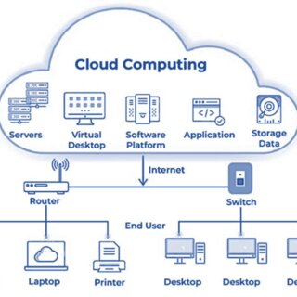
Cloud computing
Helps users in easily accessing computing resources like storage, and processing over internet rather than local hardwares.
Cloud Deployment Models:
Private cloud
Public cloud
Hybrid cloud
Multi cloud

Slide 5
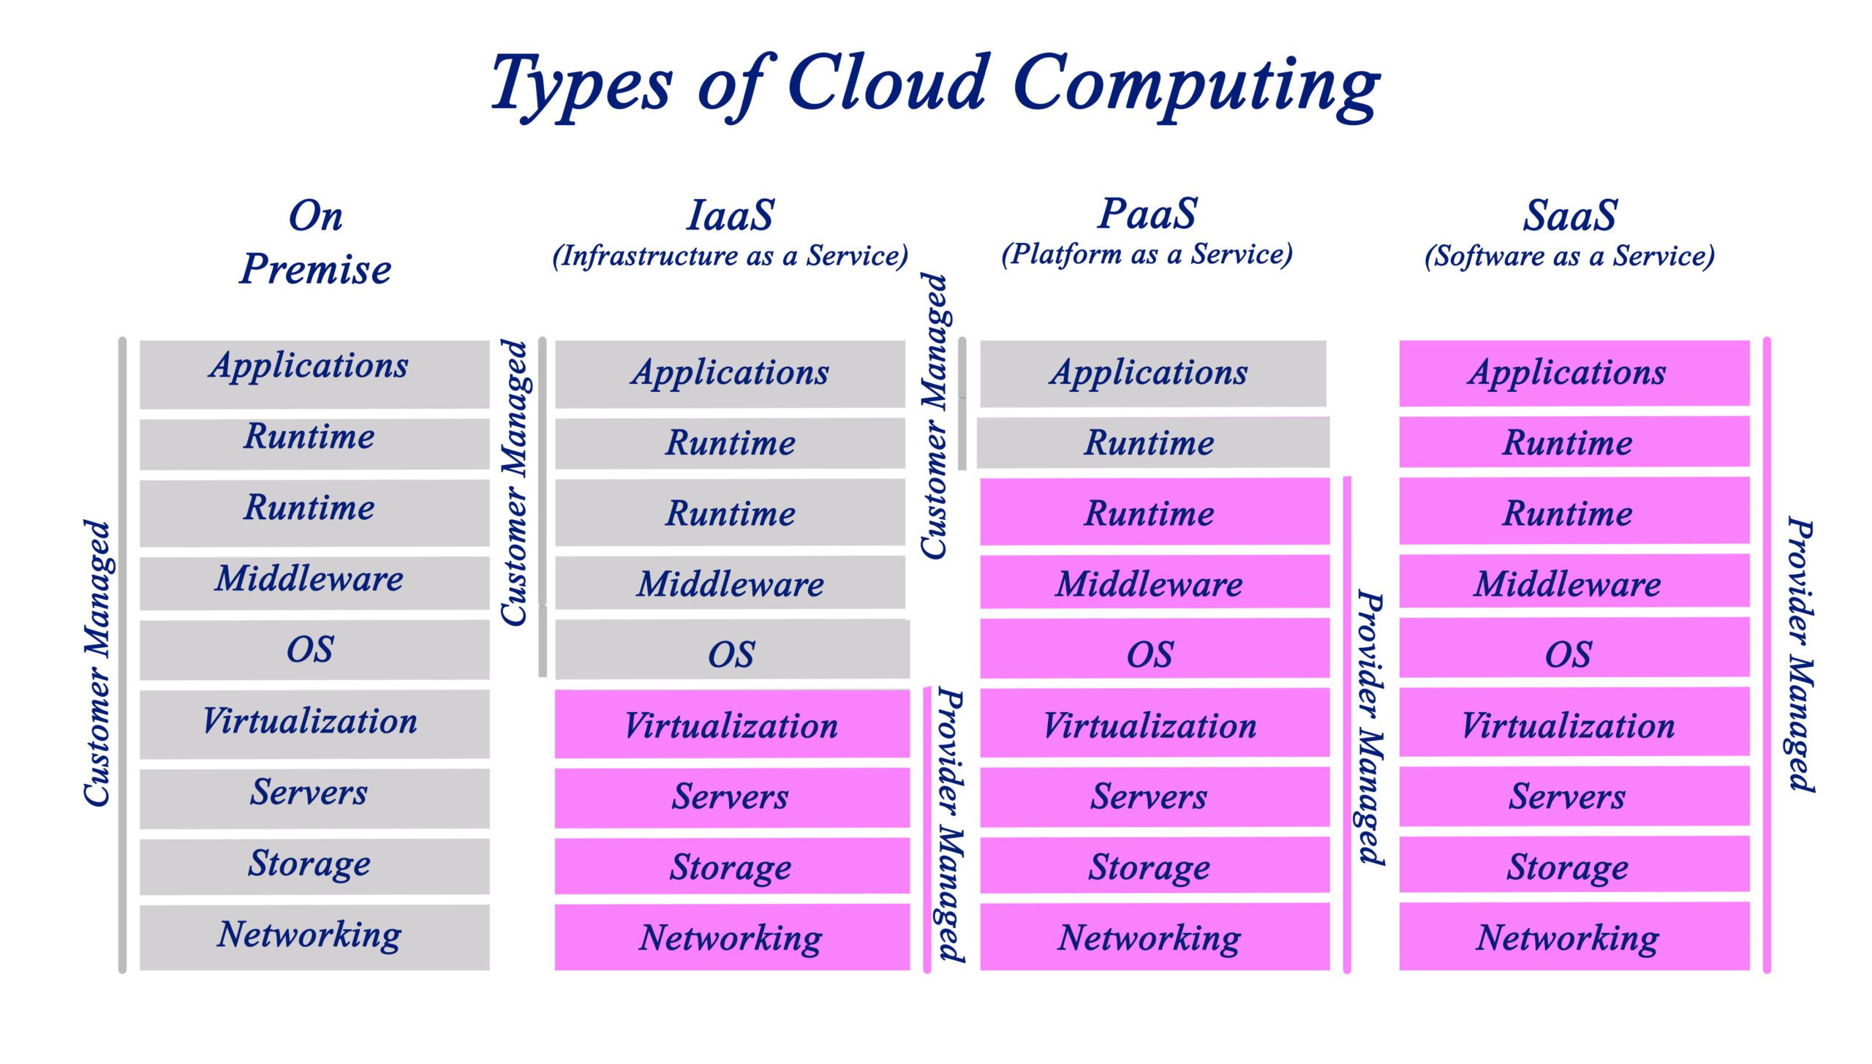
Types of cloud computing

Slide 6
Azure Networking
A services provided by Microsoft Azure that enables users to create,manage,and secure network infrastructure in the cloud.
Networks are monitored and maintained by Azure.
User has to create virtual networks,subnets,IP addresss,other network components.

Slide 7
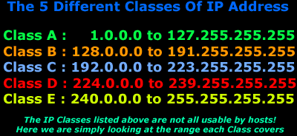
Virtual network
Vnet is a service that provides the fundamental building block for your private network in Azure.
When it is created,the services and virtual machine within Azure network interact securely with each other.
Subnetting helps in organizing and managing large networks by breaking them down into smaller, more efficient segments using CIDR.
PrivateSubnet
10.0.0.0/8, 172.16.0.0/12, 192.168.0.0/16
Public subnet.

Slide 8

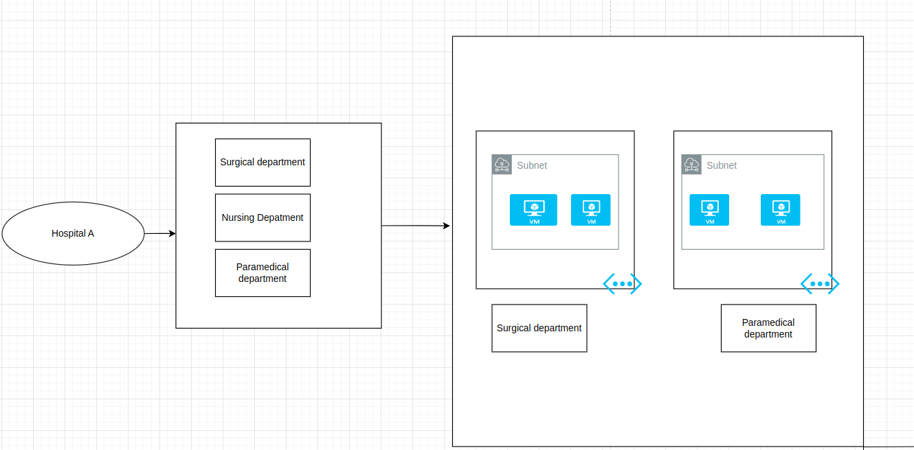

Slide 9
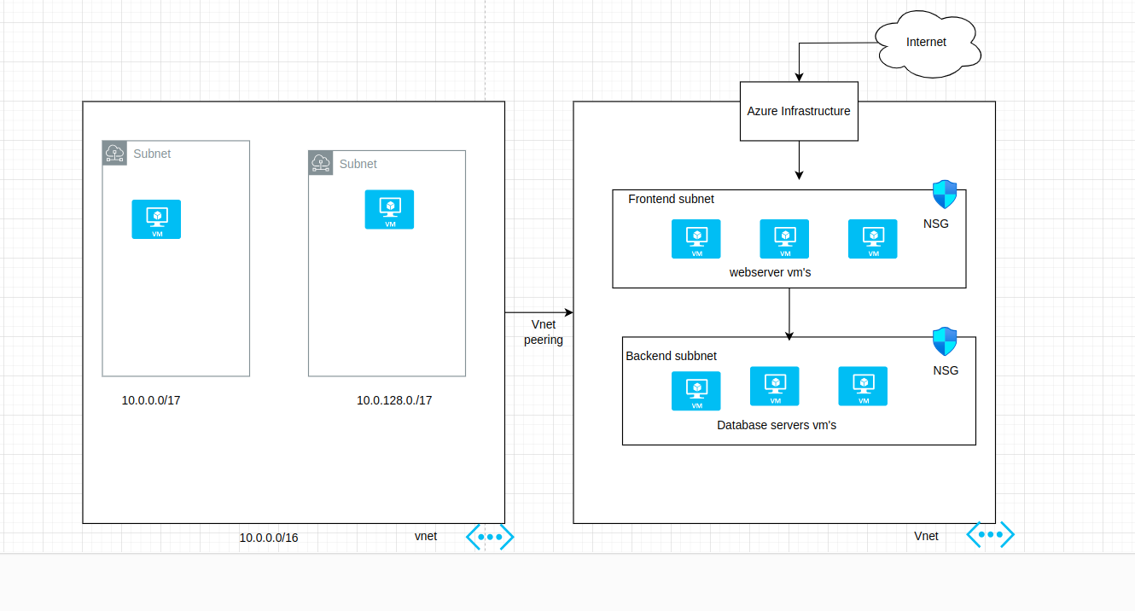

Slide 10

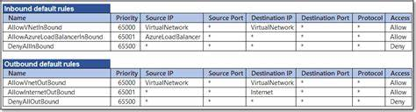
Network Security Group
NSG is a critical component in Azure that helps manage and control network traffic to and from Azure resources within a virtual network.
Contain security rules that allow or deny inbound and outbound network traffic based on various criteria such as source and destination IP addresses, ports, and protocols.
Azure provides the default security rules for both incoming and outcoming traffic in each network security group
Application Security Groups (ASGs) that enhance network security by allowing users to group virtual machines (VMs) based on their roles, functions.

Slide 11
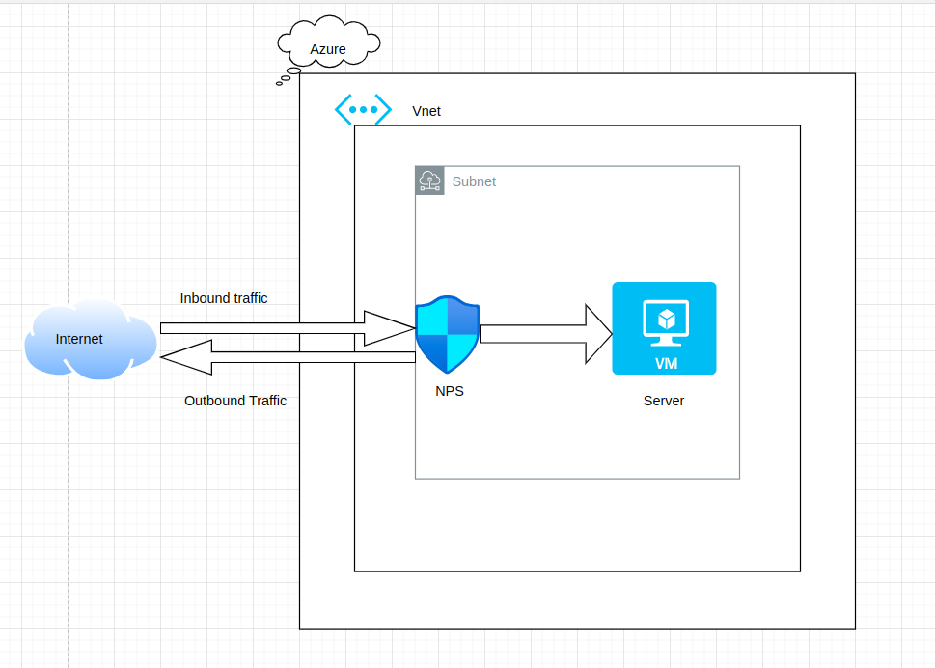

Slide 12
Service end point
Provides secure and direct connectivity to Azure services over the Azure backbone network.
Endpoints allow you to secure Azure service resources to only your virtual networks.
Service Endpoints enables private IP addresses in the VNet to reach the endpoint of an Azure service without needing a public IP address on the Vnet.

Slide 13
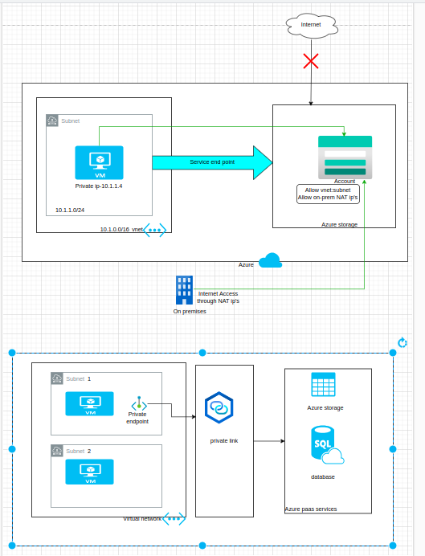


Slide 14
Azure private Link
Azure Private Link is a networking feature that provides secure and private connectivity to Azure services over a private endpoint within a virtual network (VNet).
This eliminates the need for exposing services to the public internet, enhancing security and reducing the risk of data leakage.

Slide 15


Slide 16
Azure Domain Name System (DNS)
Cloud-based DNS service that provides reliable and scalable .
It translates human-readable domain names into IP addresses, enabling users to access resources on the internet or within a private network.
Private DNS refers to a DNS service that operates within a specific organization or network, managing DNS queries exclusively for its internal users. This setup is essential for maintaining security and privacy, especially in corporate environments where sensitive data is handled.

Slide 17

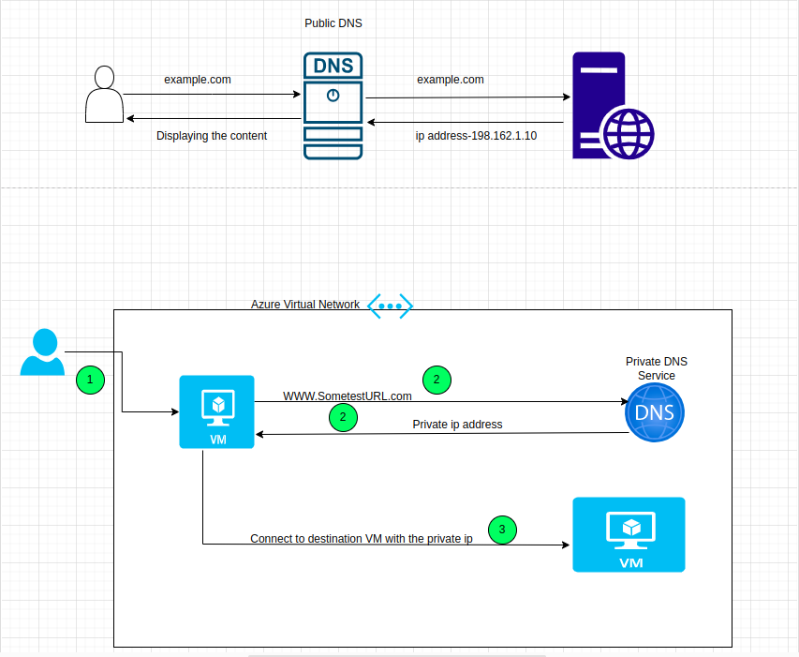

Slide 18
Azure Bastion
A bastion server, also known as a bastion host or jump server, is a special-purpose computer on a network specifically designed and configured to withstand attacks.
It allows users to connect to private instances without using external IP addresses .Azure recommends seamless SSH or RDP protocols to connect to the bastion host, which then provides access to the internal instances¹.
It acts as a gateway between a private network and an external network, providing secure access to internal resources without exposing them directly to the internet

Slide 19

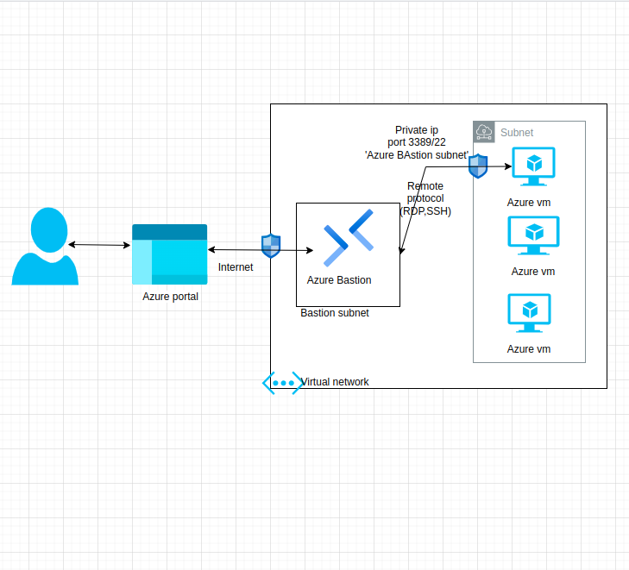

Slide 20
Route server
A fully managed service designed to simplify dynamic routing between Network Virtual Appliances (NVAs) and Azure Virtual Networks (VNets).
It leverages the Border Gateway Protocol (BGP) for the automatic exchange of routing information, eliminating the need for manual route configuration.

Slide 21

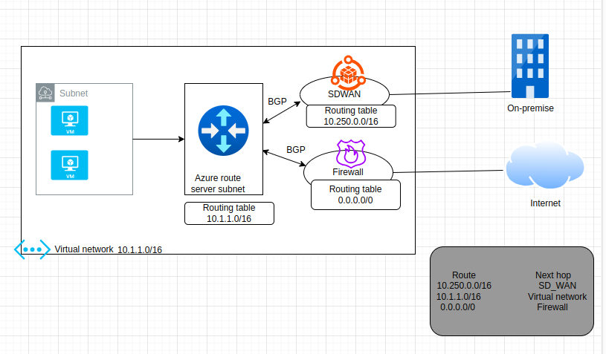

Slide 22
NAT (Network Address Translation) Gateway
Allows instances in a private subnet to connect outbound to the internet or other external services.
preventing unsolicited inbound connections from the internet.
useful for maintaining the security and privacy of instances within a private subnet.

Slide 23
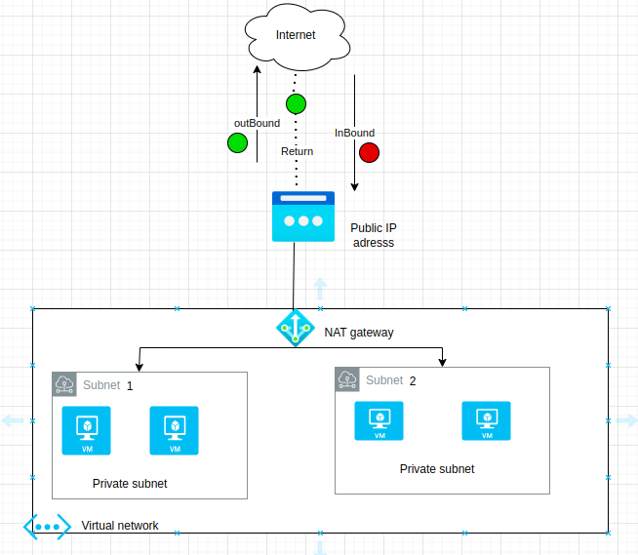


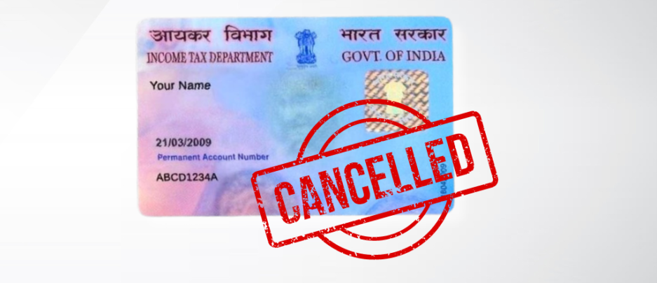

Slide 24
Traffic Manager
Is a DNS-based load balancer. This means it helps direct users to the best available application endpoint (like a server or service) based on various factors, such as location or performance.
DNS Resolution: When a user wants to access an application, their device sends a request to resolve the application's domain name into an IP address. Traffic Manager handles this request.
Traffic Routing: Based on pre-defined rules (like geographic location, performance, or priority), Traffic Manager determines which endpoint (server) will provide the best experience for the user. It then returns the appropriate IP address to the user's device.
Health Monitoring: Traffic Manager continuously checks the health of all endpoints. If one endpoint becomes unavailable, it automatically reroutes traffic to another healthy endpoint, ensuring that users can always access the application.

Slide 25
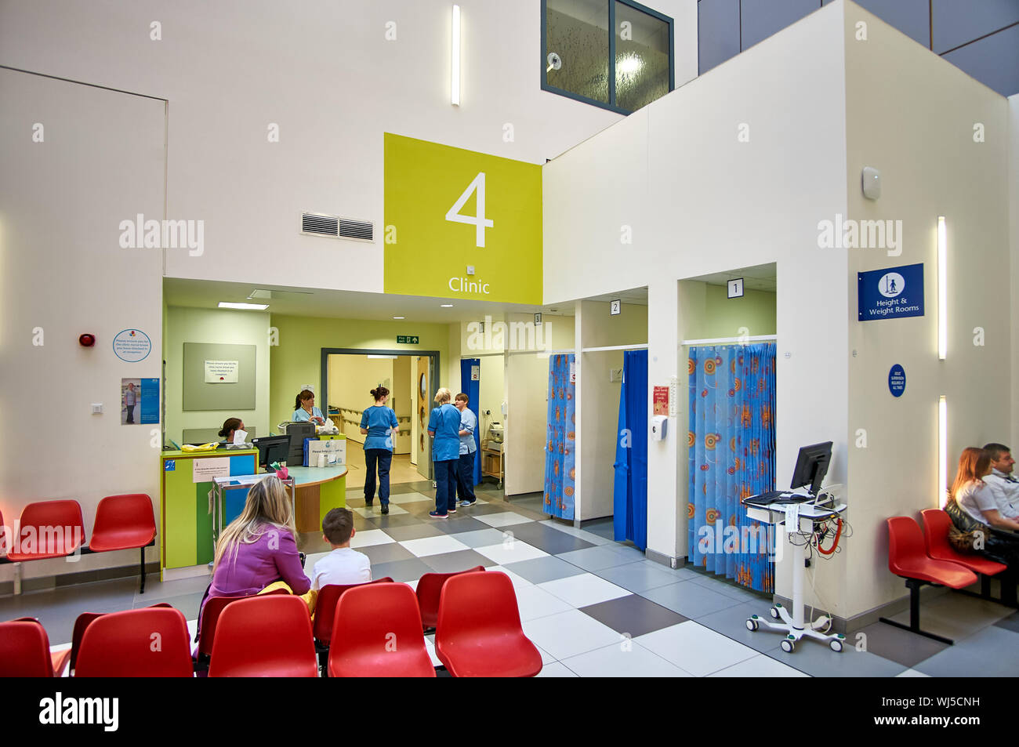
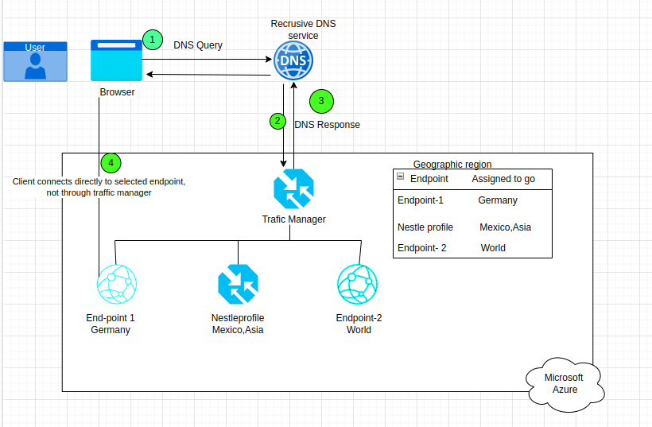

Slide 26
Thank you

